Slide 1
Application and Component System

Slide 2
Application developers can reuse OOSE model components

Slide 3
Application developers can reuse OOSE model components
Cont…
A system is a well-documented workproduct owned by an organization unit, such as a group.
Each application system is a system consisting of a set of related models and associated documents
A system is an organizational assets that require investment, version control, configuration management, development, certification, testing, packaging, maintenance and release management.
Systems are generally configurable and have attached user, installation and maintenance documents, tools and processes for installers to follow.
A system can be developed by breaking them into pieces or workproduct

Slide 4
Application developers can reuse OOSE model components
Cont…
Workproduct
  Unit of code, a document or piece of software model that can be independently managed within a software engineering organization.
  Ex. Individual types, classes and other model elements, diagrams etc.
  Complete models, subsystems and test models are also workproducts
  Ex.
    Configuration file
    Listing the names and version of other software workproducts that are intended to be used together.

Slide 5
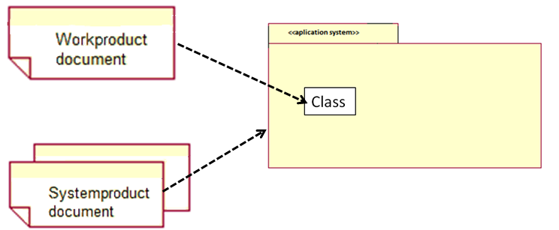
Application developers can reuse OOSE model components
Cont…
Application system is a system product delivered outside of the reuse business.
When installed, an application system offers a coherent set of use cases to an end user.

Slide 6
Application families allow significant reuse
Application System Family is a set of application systems with common features.
Types:
  Application System Suite is a set of different application systems that are intended to work together to help some actors accomplish their work. Ex. Microsoft Office Suite etc.
  Application System Variants are useful when same application system need to be configured, packaged and installed differently for different users. Ex. Ericsson AXE family of telecommunications switching system
  Fairly Independent Application System build from the same set of lower-level reusable components. Ex. Application system with similar Windows behavior can be built from the MFCs.

Slide 7
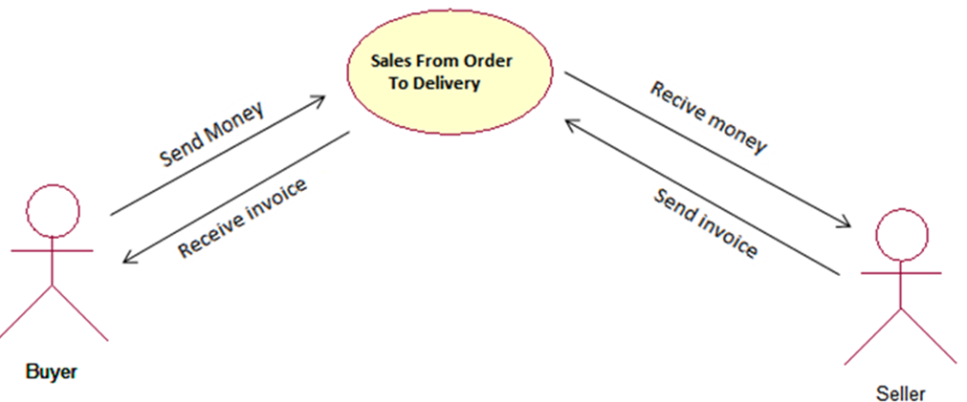
Application families allow significant reuse
Cont…
The business process sales from order to delivery is a customizable, configurable component.
Here, there are two application systems: Payment and Invoicing
Invoicing is used by Seller to request payment for some service or goods and later to follow up the payment of invoices.
Payment is used by a Buyer to pay received invoices.

Slide 8
Application systems are built from reusable components
Cont…
  A component is a type, class or any other workproduct that has been specifically engineered to be reusable.
    It includes use case, analysis, design and implementation model elements etc.
    Components are designed, packaged and documented to be reusable
    Cohesive and has a relatively stable public interface
    May be very general and reusable in many types of application systems
    May be limited and specific to only a certain business area

Slide 9
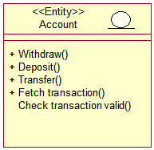
Application systems are built from reusable components
Cont…
Buyer can use Payment and ATM Cashier of Account component for transactions.

Slide 10
Group components into component systems
A component system is a system product that offer a set of reusable features.
Features are implemented as related and interconnected sets of components of various types, associated packages and descriptive documents
Components should be carefully modeled, implemented, documented and tested to allow effective future maintenance and evolution.
Application systems reuse common components by importing reusable components from the component systems.
Component systems include façade for providing to application system development.

Slide 11
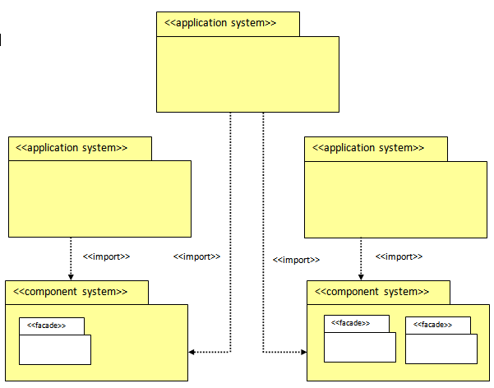
Group components into component systems
Cont…

Slide 12
Facades control access to component system internals
  Façade is a packaged subset of components or references to components, selected from the component system.
  It provides public access to only those parts of the component system that have been chosen to be available for reuse.
  Insulates a reuser from the specific details of how a component system is implemented and allows internal changes without necessarily impacting the reuser
  Encapsulate the internals of the component system in order to minimize dependencies and rippling change as the component system evolves.

Slide 13
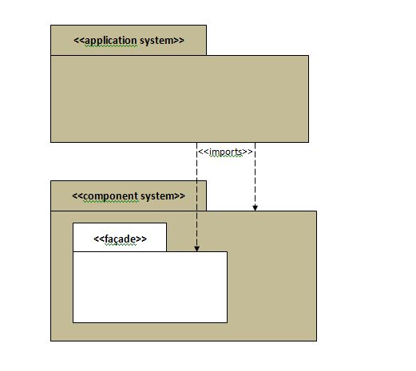
Facades control access to component system internals
Cont…

Slide 14
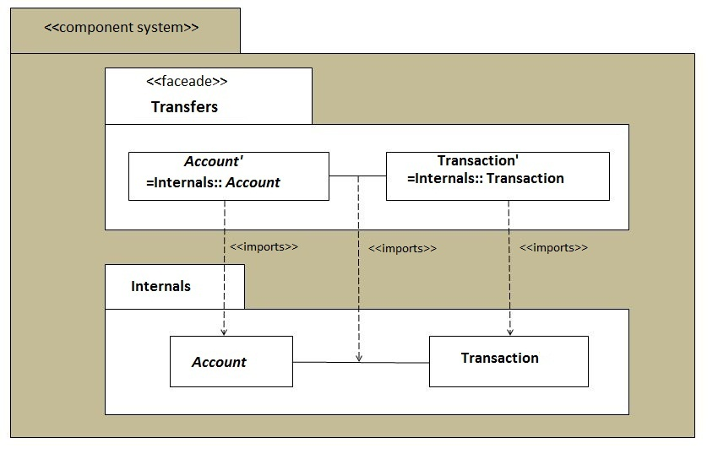
Facades and Component System are special kinds of packages

Slide 15
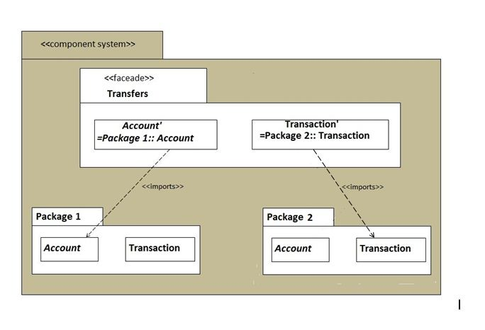
Facades and Component System are special kinds of packages
Cont…

Slide 16
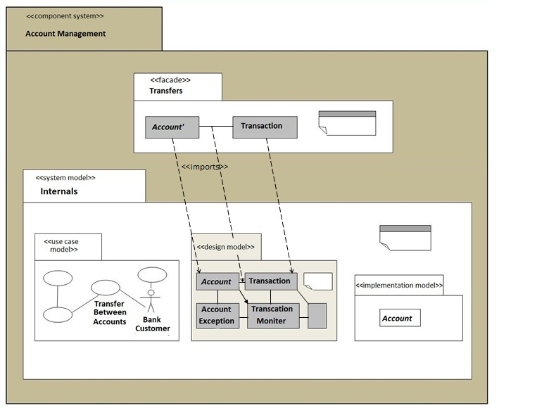
Facades and Component System are special kinds of packages
Cont…

Slide 17
Component systems export component via facades
  Each component system exports a set of reusable components; that is make them publicly accessible for reuse
  Only those elements that reuser (application engineers) need to “connect to” directly are exported via façade
  Façade defines an alternative exported set of related components offering an independent and consistent way of reuse
  Change in component should affect the façades where the component is exported and thus only the reusers of those facades
  Older facades should continue to exist for backward compatibility as component system evolve.

Slide 18
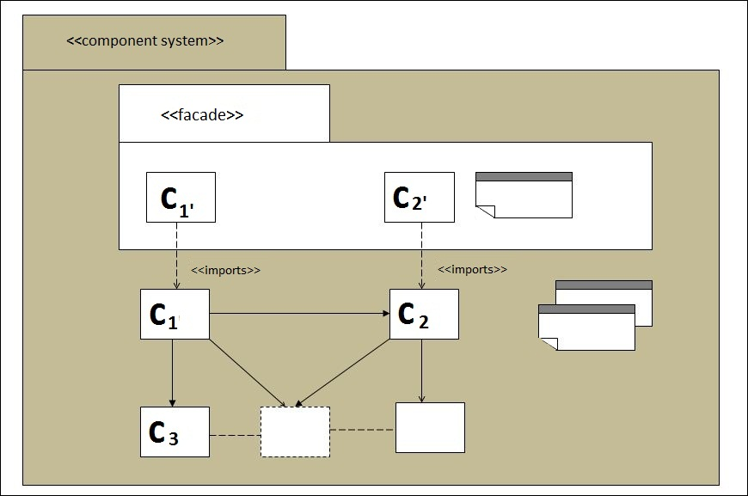
Component systems export component via facades
Here, the component system exports some type or classes, C1 and C2, and documents via a façade, while the other type, classes C3 … are hidden in the internals of the component system.

Slide 19
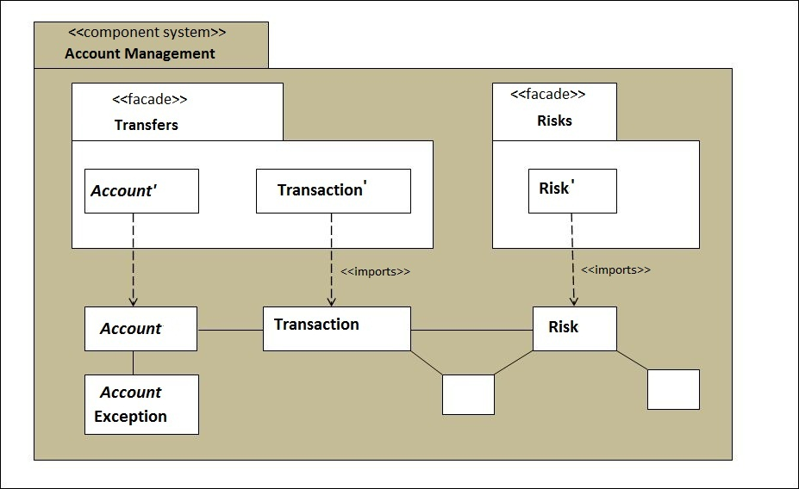
Component systems export component via facades
Account management component system exports components organized into separate facades Transfers and Risks.

Slide 20
Component systems export component via facades
When an application system imports a component from a façade, a UML reference to the component is included in the appropriate model of the application system.
Payment application system reusing several imported components.
For example, account “ is imported type.

Slide 21
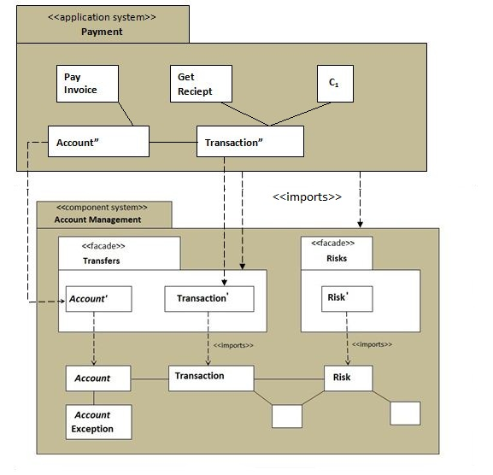
Component systems export component via facades

Slide 22
Specialize some components before reuse
For effective reuse, many of the components exported by a component system need to offer some degree of variability.
To accommodate the differences between individual application system
    We might need a large number of similar but distinct as-is component
    We can build a small number of more flexible, general components
  General component need to be specialized in some way before reuse
  Variability mechanisms
    Provide different ways of specializing reusable components
  Ex. Netron CAP/Fusion, Ericsson AXE, Visual Basic Active X

Slide 23
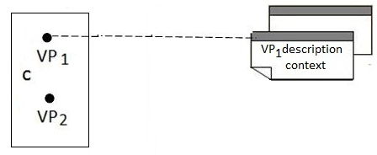
Variability occurs at variation points
Feature is a use case, part of a use case or responsibility of a use case
Variable feature are exported at variation points
Variation point identifies one or more locations at which the variation will occur.
An abstract component is specialized by attaching one or several variants to its variation point.

Slide 24
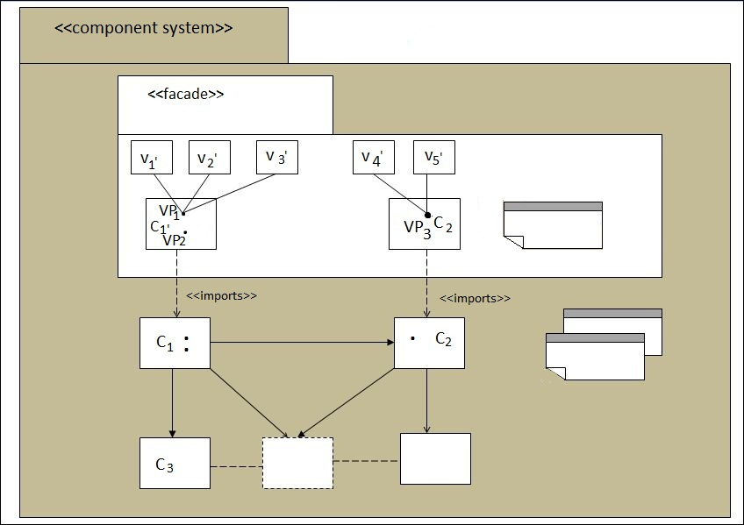
Variability occurs at variation points
Cont…

Slide 25
Use several kinds of variability mechanisms
Mechanism | Type of VP | Type of variant | Use particularly when
Inheritance | Virtual operation | Subclass or subtype | Specializing and adding selected operations while keeping others
Extenstions | Extension point | extension | It must be possible to attach several variants at each variation point at the same time
Uses | Use point | Use case | Reusing an abstract use case to create a specialized use case
Configuration | Configuration item slot | Configuration item | Choosing alternative functions and implementations
Parameters | parameter | Bound parameter | There are several small variation points for each variable feature
Template instantiation | Template parameter | Template instance | Doing type adaptation or selecting alternative pieces of code
Generation | Parameter or language script | Bound parameter or expression | Doing large-scale creation of one or more types or class from a problem specific language

Slide 26
Use several kinds of variability mechanisms
Cont…
Using Inheritance
  Useful for subtyping
  Defined as a type essentially the specification of a set of “virtual “ or “dummy” operations in the superclass
  Class (or type) Inheritance
    Reduce the encapsulation and open up the internals of the class to subclass
  Deep Class Hierarchies
    YoYo Problem-difficult to understand which operations invoke when an instance call several internal operations at different level in the hierarchy
    Hard to localize changes
    Difficult to test abstract class and to decide what to test and retest when adding subclass

Slide 27
Use several kinds of variability mechanisms
Cont…
Using Extensions
  A use case type or object type or class extension is a use case type or object type or class that adds new responsibilities or behavior(extends) another use case type or object type or class
  It is a variant attached at a variation point called an extension point
  Small type or class that cannot be used by itself
  It may be
    Implicit- not directly visible at all in the component system
    Explicit-visible and documented in the component

Slide 28
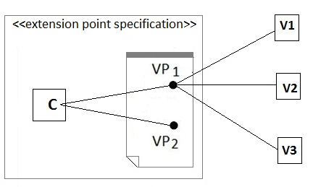
Use several kinds of variability mechanisms
Cont…
Using Extensions

Slide 29
Use several kinds of variability mechanisms
Cont…
Using parameterization, templates, and macros
  Simple but powerful technique to express component variability
  Parameterization can be used in the
    description of a use case
    Name of a type or class
    Operation definition
    Body of a method
  Most suitable when the feature variants are small

Slide 30
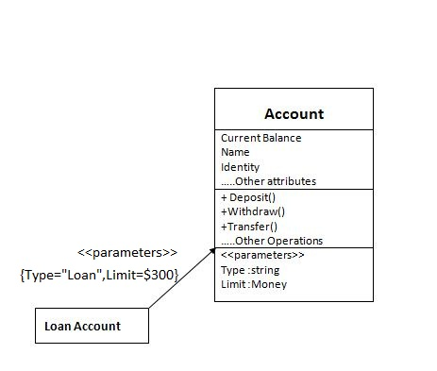
Use several kinds of variability mechanisms
Cont…

Slide 31
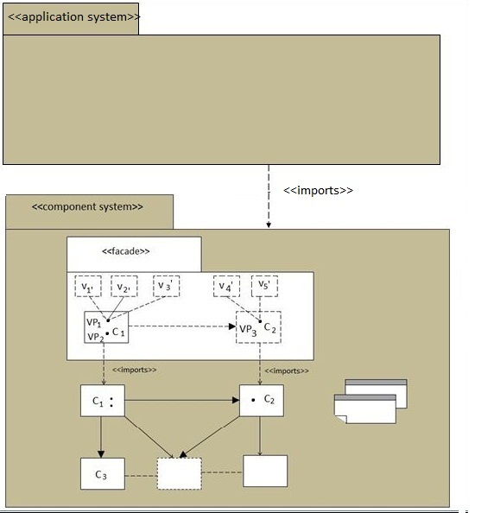
Reuse variable components to build application systems

Slide 32
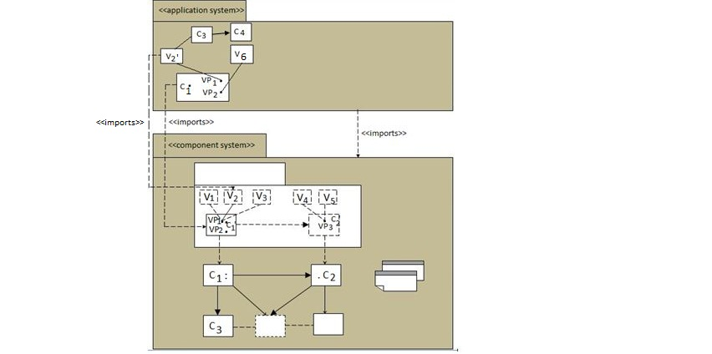
Reuse variable components to build application systems
Cont…

Slide 33
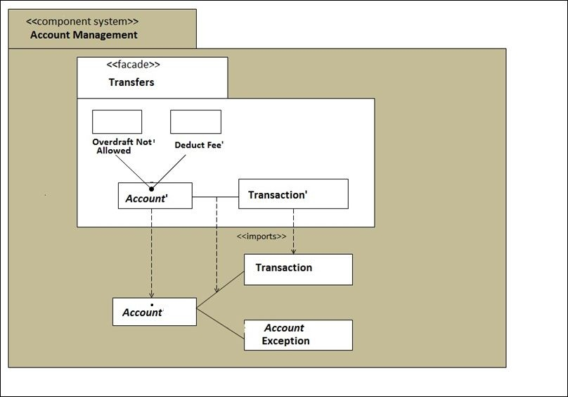
Reuse variable components to build application systems
Cont…

Slide 34
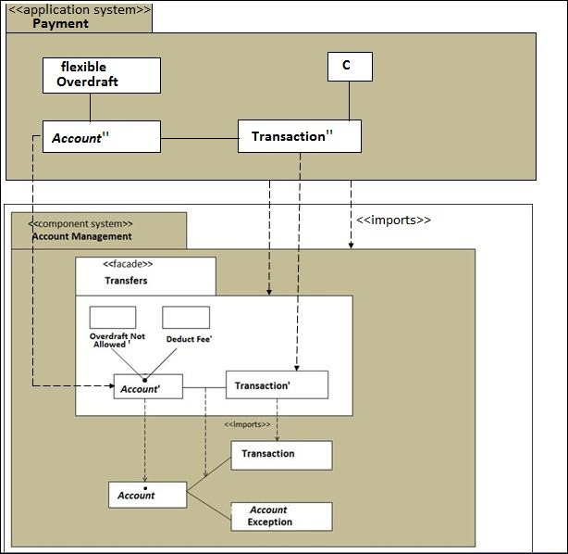
Reuse variable components to build application systems
Cont…

Slide 35
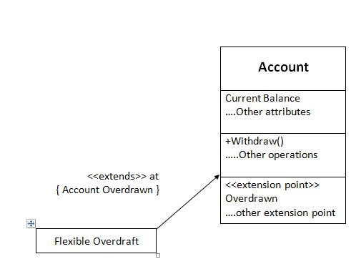
Reuse variable components to build application systems
Cont…

Slide 36
Package and document component systems for reuse
Package and document a component system in terms of its exported components, variants and facades.
Component system and façade will be broken into pieces for configuration management
Configuration consists of particular version of configuration items
Configuration item is a segment of a model that is subject to version control
Use to support the implementation of a simple form of variability, by selecting alternate configuration item to import the alternate component for as-is reuse

Slide 37
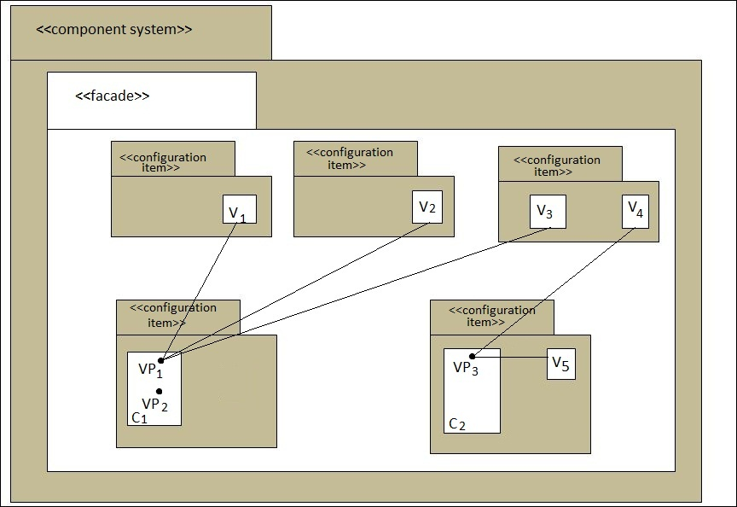
Package and document component systems for reuse
Cont…

Slide 38
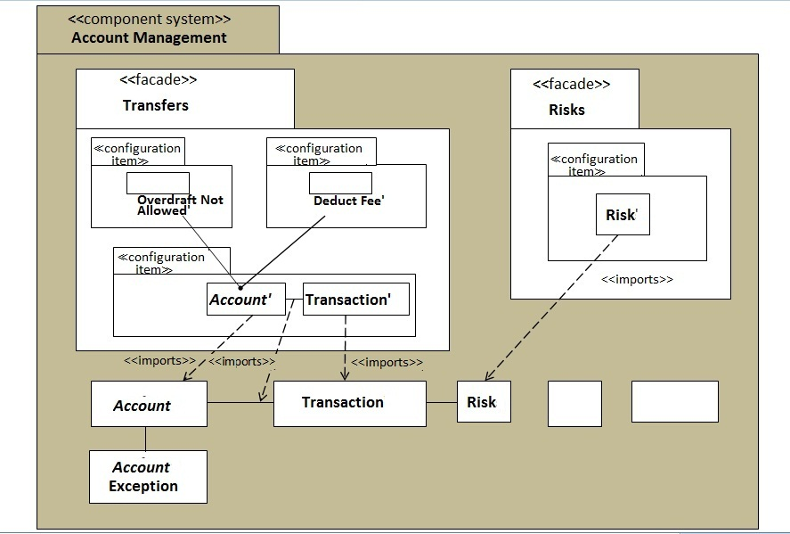
Package and document component systems for reuse
Cont…

Slide 39
Exercises
Design an ActiveX control in VB and customize them for Wizard, generator, builders program language and add-ins.
Design a template in C++ to customize for various applications. Explain the variability usage in template design.
Using inheritance principle in C++, explain variability mechanism with example?

